Slide 1

Digital Record Integration: Optimizing Data for Business Growth
Submitted By- PIYUSH RAJ

Slide 2
Introduction :-
A Digital Record Integration (DRI) project in database management involves combining various data sources into one unified system. This project focuses on making data easier to manage, access, and analyze.

Slide 3
Importance of Digital Record Integration
Improved Efficiency
Real-time Data Access
Enhanced Collaboration
Cost Savings
Data Accuracy

Slide 4
Project Overview :-
Centralized Platform
Digitization
Real-Time Updates
Security
Workflow Automation

Slide 5
Project Objective :-
Better Collaboration
Scalability
Cost Reduction
Enhanced Data Accuracy

Slide 6
Requirement Gathering :
Interviews :-
Purpose of Interviews:
Collect in-depth feedback from key stakeholders on current record management systems.
Understand user perspectives on processes, inefficiencies, and security issues.
Survey :-
Purpose of Surveys:
Gather quantitative insights from a broad group of employees across departments.
Identify common issues and prioritize desired features based on user feedback.

Slide 7
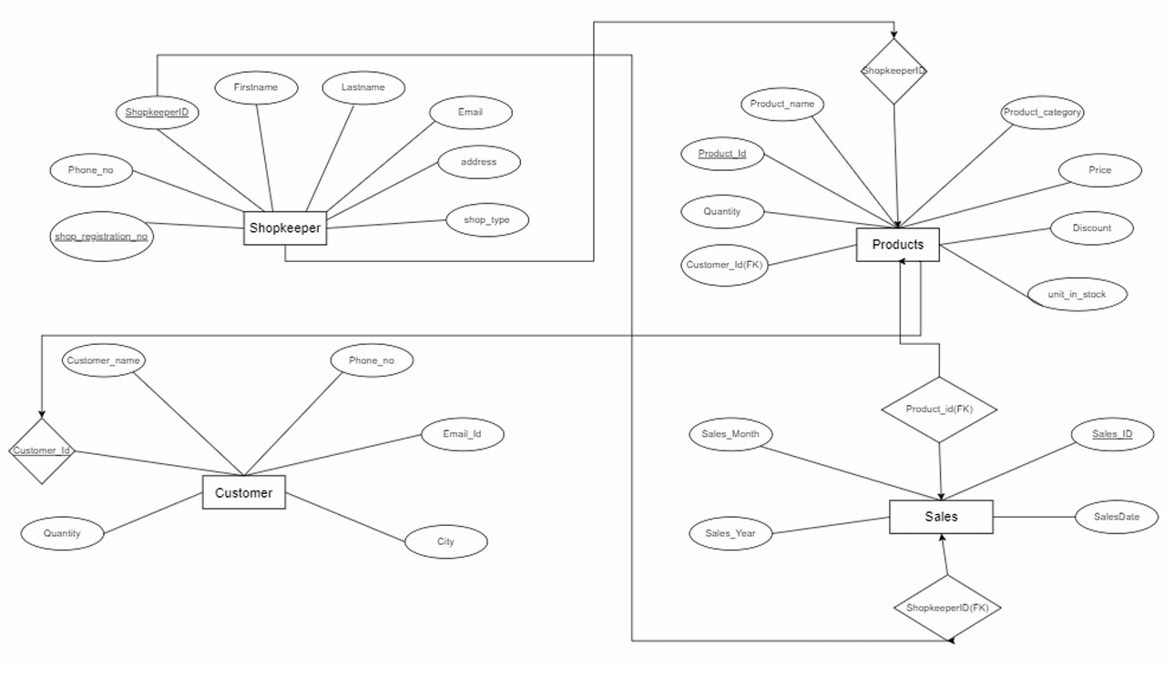
ER Diagram

Slide 8
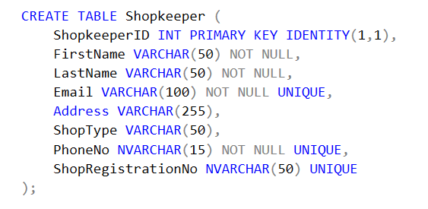
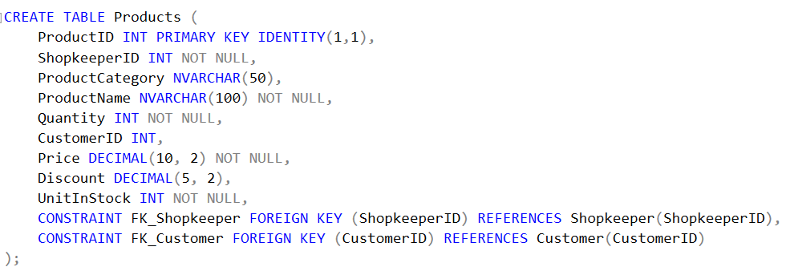
Database Tables :

Slide 9
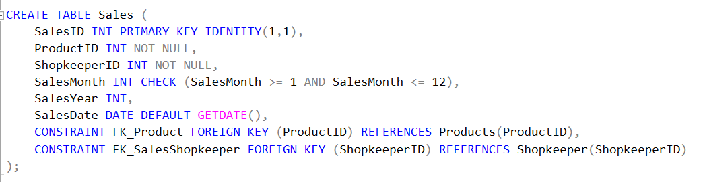
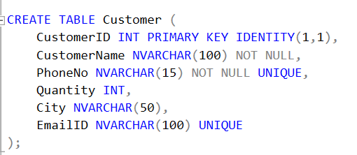
Database Tables :

Slide 10
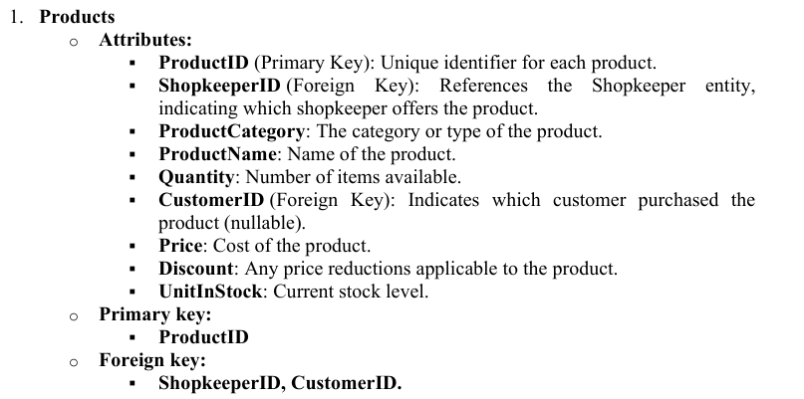
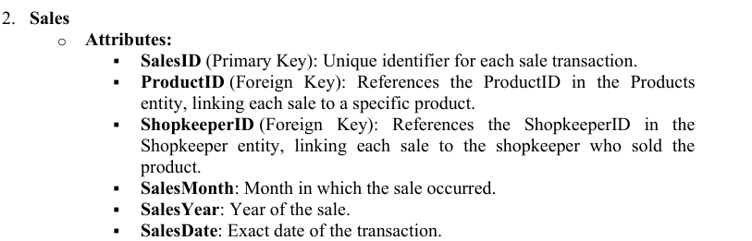
Database Design and Normalization :

Slide 11
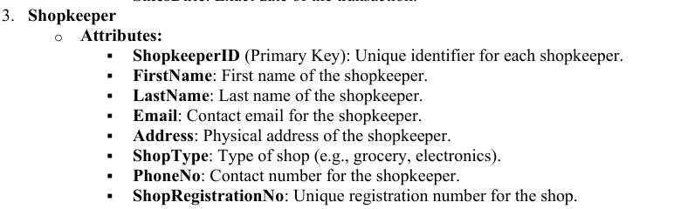
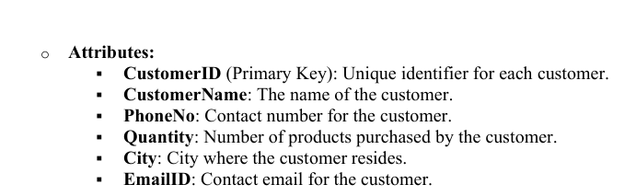
Database Design :
4. Customer

Slide 12
Normalization :
Customer to Products :
Relationship Type: Many-to-Many
Description: A customer can purchase multiple products, and a product can be purchased by multiple customers. This relationship is represented through the CustomerID in the Products table.
Shopkeeper to Products:
Relationship Type: One-to-Many
Description: A shopkeeper can offer multiple products, but each product is associated with only one shopkeeper.
Shopkeeper to Sales :
Relationship Type: One-to-Many
Description: A shopkeeper can have multiple sales transactions, but each sale is linked to only one shopkeeper.
Products to Sales:
Relationship Type : One-to-Many
Description: A product can be sold in multiple sales transactions, but each sale corresponds to only one product.

Slide 13

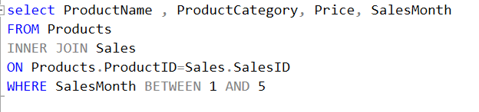
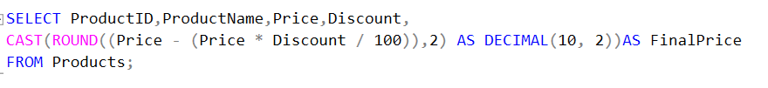
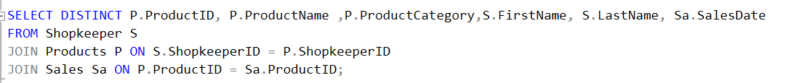
SQL QUERIES :

Slide 14
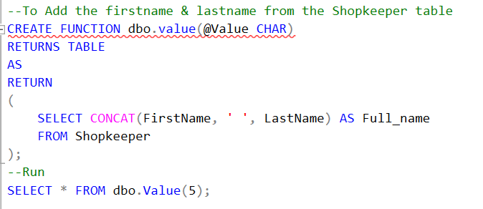
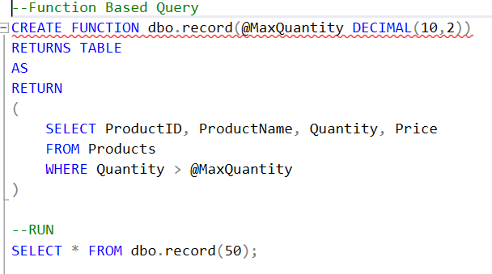
PL-SQL QUERIES :

Slide 15
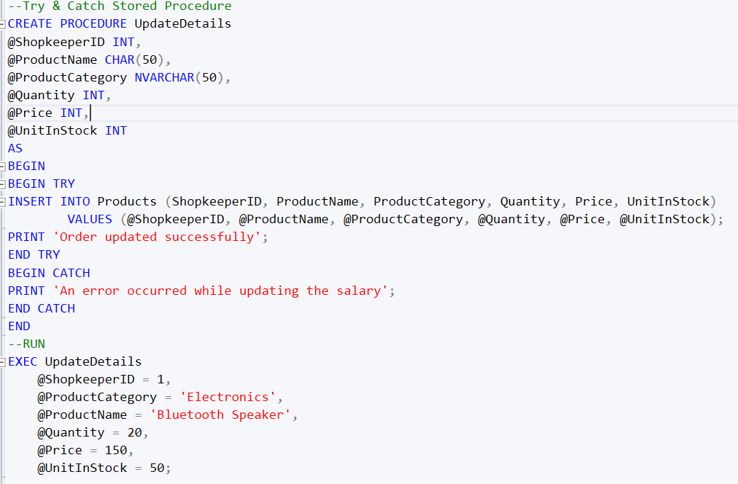
PL-SQL QUERIES :
Using try & catch :-

Slide 16
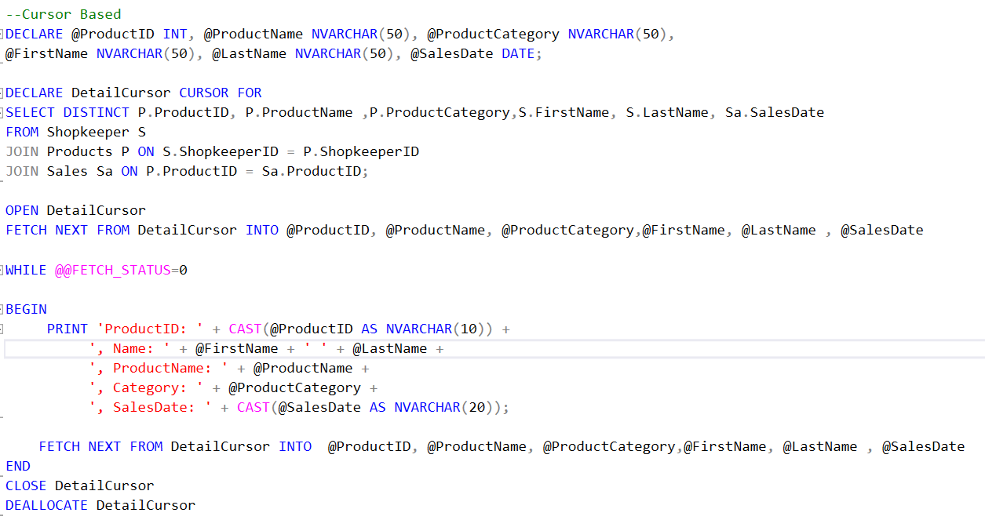
PL-SQL QUERIES :
Using Cursor:-

Slide 17
Conclusion :
The Digital Record Integration Project successfully created a centralized system for managing shopkeeper data, product inventory, and sales transactions.
The system automates stock updates and sales tracking, improving operational efficiency.
Customer data is linked to sales, offering valuable insights for personalized services.
The system is scalable, supporting future growth and making it a reliable tool for business operations.
Overall, the project enhances decision-making and optimizes business operations.

